Slide 1
Solitaire
Alexander Baird

Slide 2
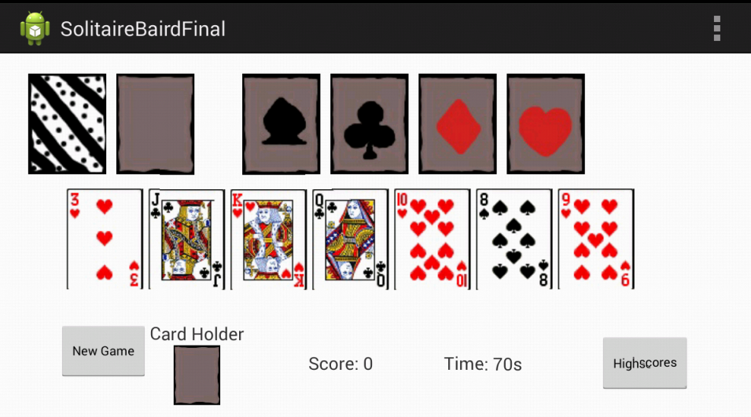
What is my Project
My project is an android version of Solitaire
  Solitaire is a game where your objective is to sort all of the cards into four stacks based on their suit.

Slide 3





My motivation for making this
I want to be a video game designer

Slide 4




My motivation for making this
Solitaire is a game I know very well.

Slide 5
Technology/Implementation Details/ Challenges
Challenges
  Setting up the drag Listeners
    Managed to get it to drag the view, but would send images and cards to oblivion when tried to drop the view.

Slide 6

Technology/Implementation Details/ Challenges
  Handling the screen flip
    At first had not realized that could lock the layout to a particular format (landscape or portrait)

Slide 7
Technology/Implementation Details/ Challenges

Slide 8
Technology/Implementation Details/ Challenges

Slide 9
Technology/Implementation Details/ Challenges

Slide 10
Technology/Implementation Details/ Challenges

Slide 11
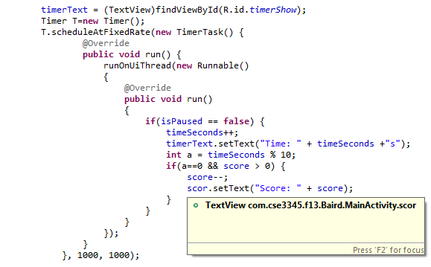
Techniques/Technology/Components that we did not use in class
Timer
  Used when dealing with time
  Can be set for different intervals than seconds

Slide 12
Techniques/Technology/Components that we did not use in class
OnDragListener
  Suppose to handle what happens when you drag a view

Slide 13
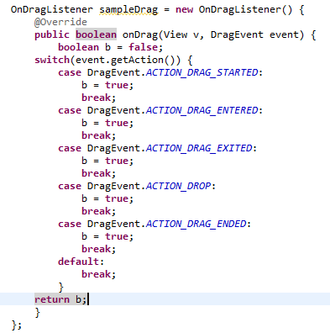
Techniques/Technology/Components that we did not use in class
  DragListeners have a number of events that must be defined within the onDrag

Slide 14
Techniques/Technology/Components that we did not use in class
OnTouchListener
  Handles events when you touch a particular view
  This or OnLongClickListener must be used alongside OnDragListener.

Slide 15
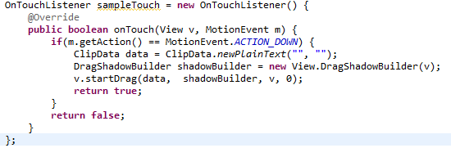
Techniques/Technology/Components that we did not use in class
  In order to have a touch listener prepare things for a drag listener, a ClipData, and a DragShadowBuilder must created, then along with the view and a 0, forwared to the method: startDrag

Slide 16
Techniques/Technology/Components that we did not use in class

